Slide 1
Lecture 15: Pointer – Part II
Class page: https://github.com/tsung-wei-huang/cs1410-40
Dr. Tsung-Wei Huang
Department of Electrical and Computer Engineering
University of Utah, Salt Lake City, UT
Notes:
Morning everyone
Today we are looking into control flow in C++.

Slide 2
Pointer Expression and Arithmetic
Pointers are valid operands in arithmetic expressions, assignment expressions and comparison expressions.
pointer arithmetic—certain arithmetic operations may be performed on pointers:
increment (++)
decremented (--)
an integer may be added to a pointer (+ or +=)
an integer may be subtracted from a pointer (- or -=)
one pointer may be subtracted from another of the same type

Slide 3
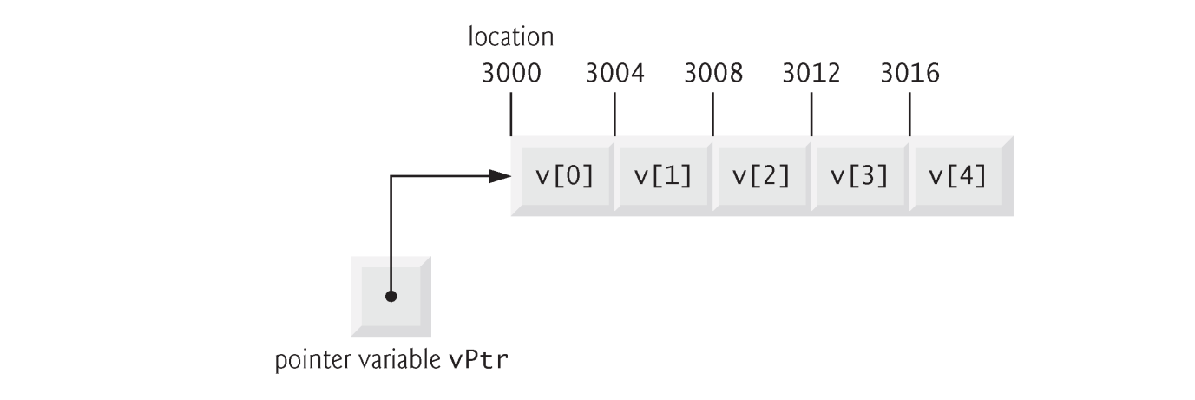
Pointer Expression and Arithmetic
Assume that array int v[5] has been declared and that its first element is at memory location 3000.
Assume that pointer vPtr has been initialized to point to v[0] (i.e., the value of vPtr is 3000).

Slide 4

Pointer Expression and Arithmetic
In conventional arithmetic, the addition 3000 + 2 yields the value 3002.
Not true for pointer arithmetic
When an integer is added to, or subtracted from, a pointer, the pointer is incremented or decremented by that integer times the size of the object to which the pointer refers
The number of bytes depends on the object’s data type.

Slide 5
Pointer Expression and Arithmetic
Pointer variables pointing to the same array may be subtracted from one another.
For example, if vPtr contains the address 3000 and v2Ptr contains the address 3008, the statement
x = v2Ptr - vPtr;
would assign to x the number of array elements from vPtr to v2Ptr—in this case, 2.
Pointer arithmetic is meaningless unless performed on a pointer that points to an array.

Slide 6
sizeof Operator
The unary operator sizeof determines the size of an array (or of any other data type, variable or constant) in bytes during program compilation.
When applied to the name of an array, the sizeof operator returns the total number of bytes in the array as a value of type size_t.
When applied to a pointer parameter in a function that receives an array as an argument, the sizeof operator returns the size of the pointer in bytes—not the size of the array.

Slide 7
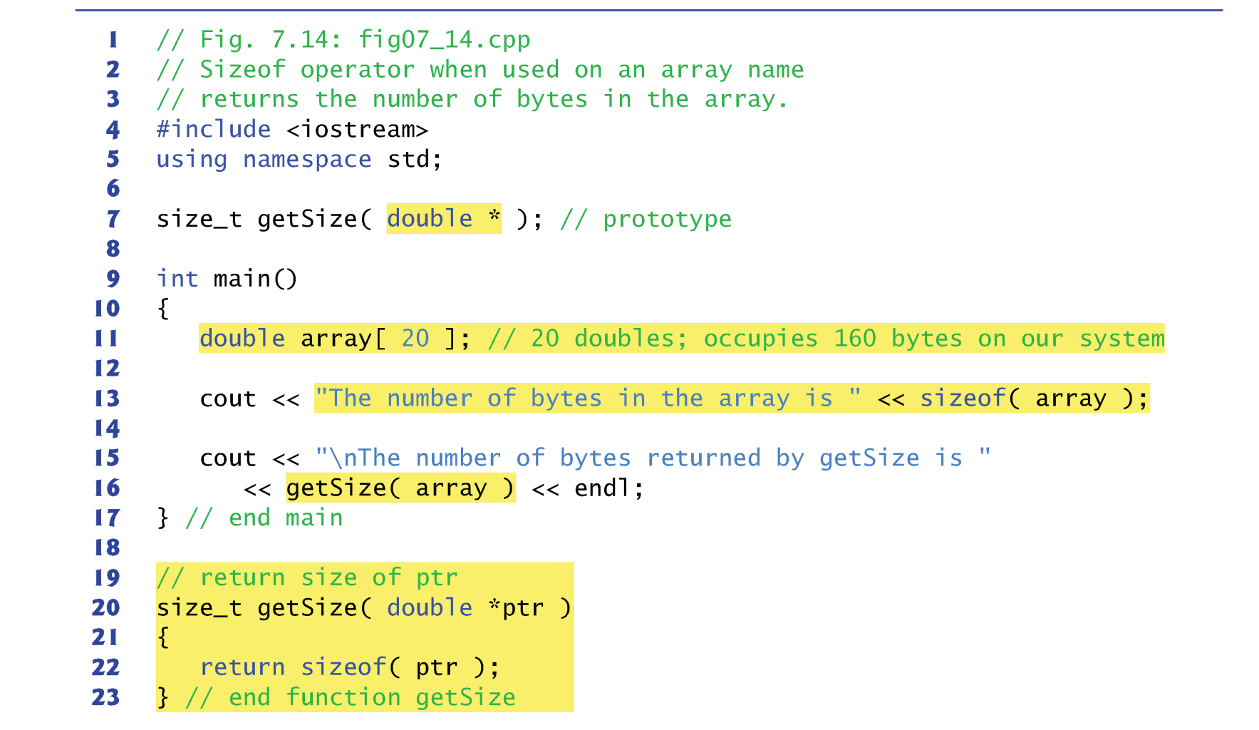
Example

Slide 8
sizeof Operator
The number of elements in an array also can be determined using the results of two sizeof operations.
Consider the following array declaration:
double realArray[ 22 ];
To determine the number of elements in the array, the following expression (which is evaluated at compile time) can be used:
sizeof realArray / sizeof( realArray[ 0 ] )
The expression determines the number of bytes in array realArray and divides that value by the number of bytes used in memory to store the array’s first element.

Slide 9
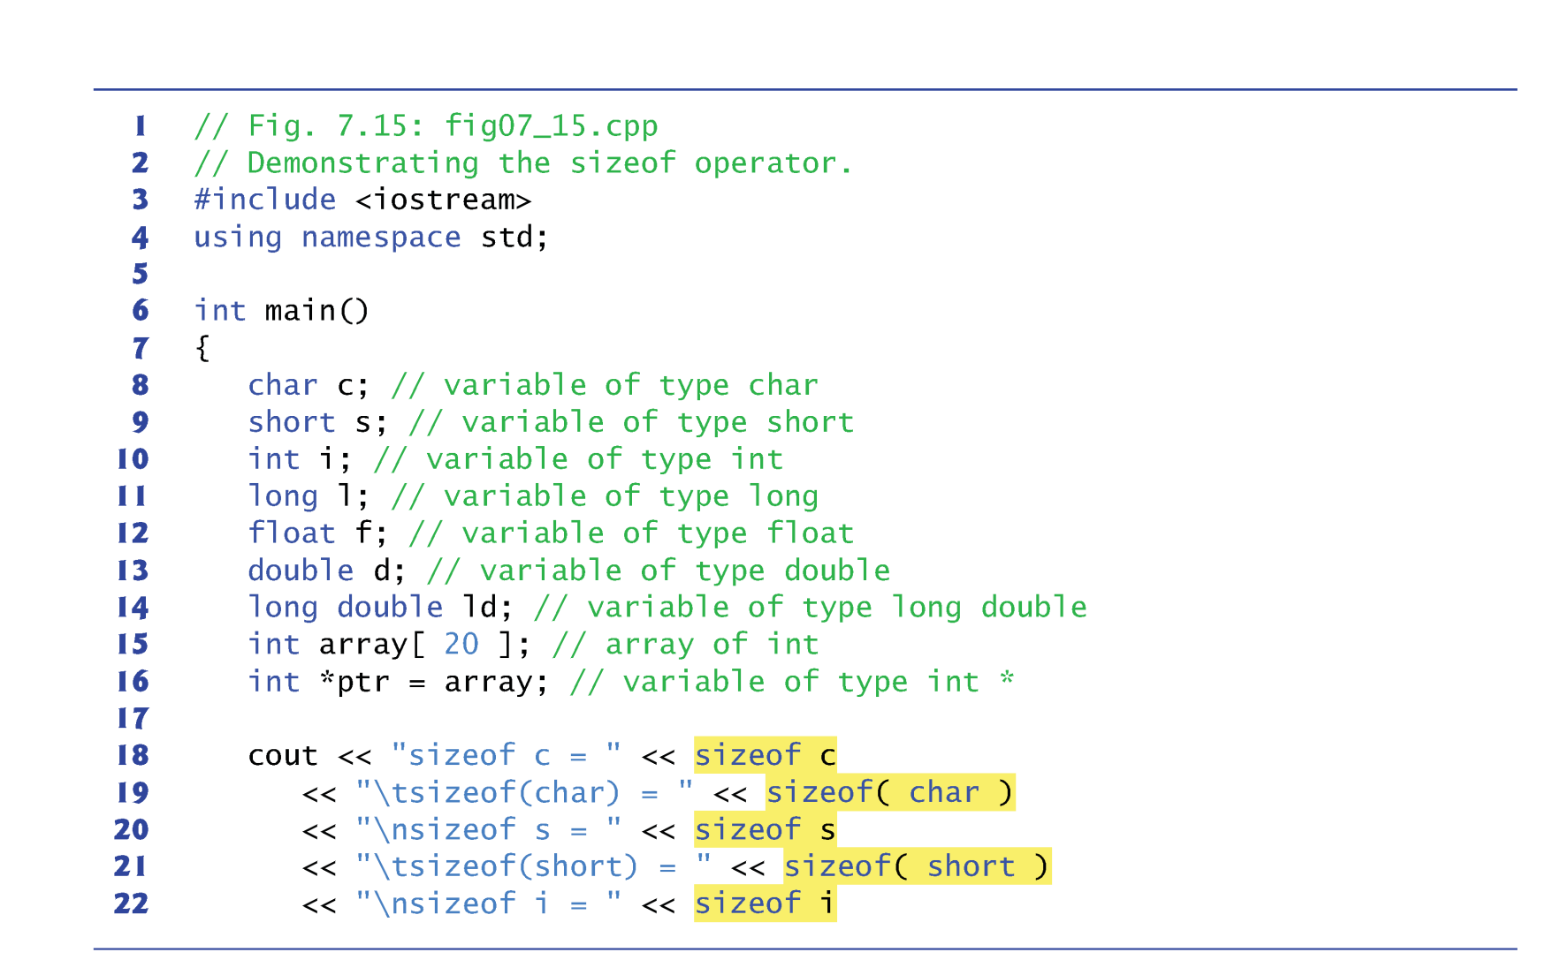
Bytes of Types

Slide 10
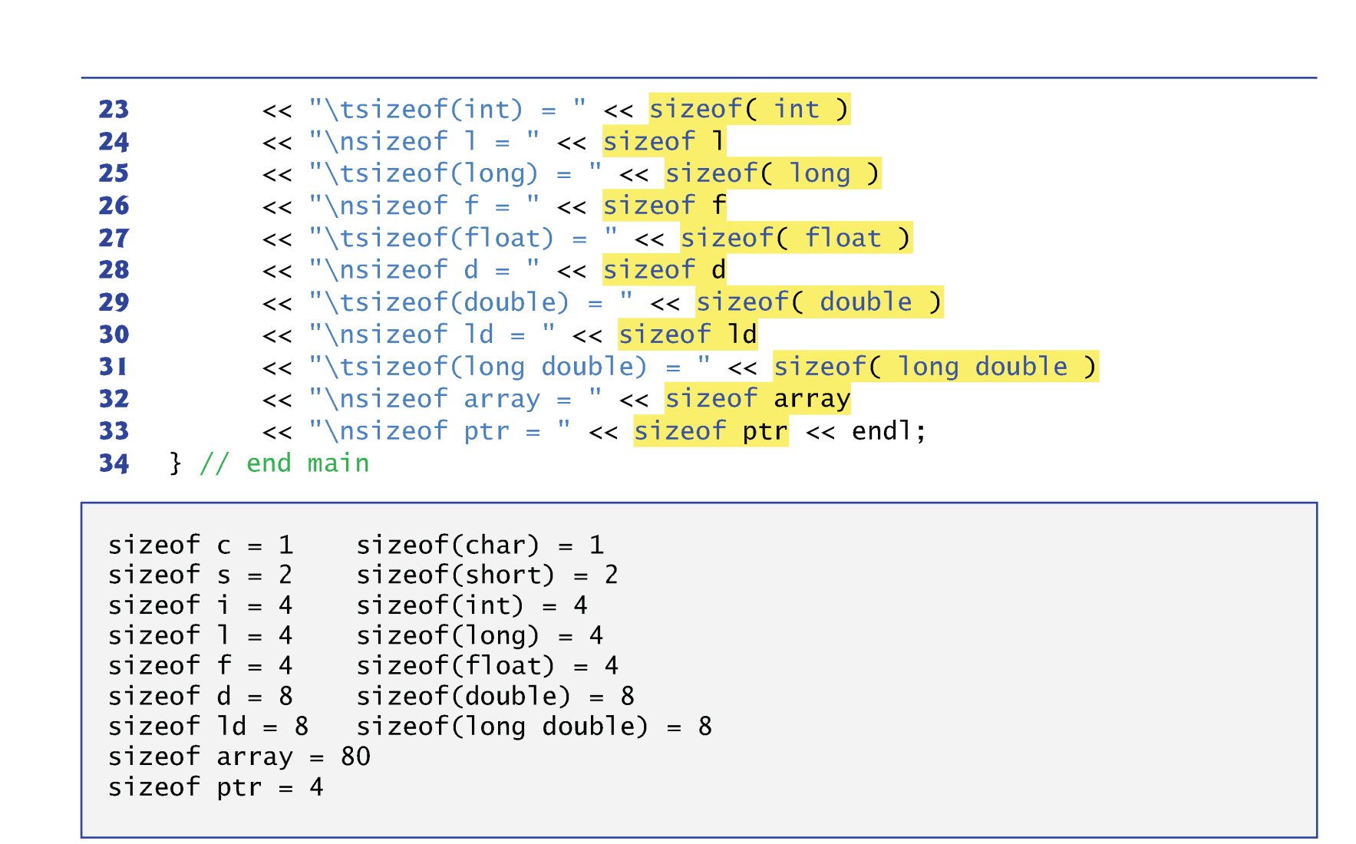
Bytes of Types

Slide 11
Relationship between Pointers and Array
The array name (without a subscript) is a constant pointer to the first element of the array.
Although it’s a pointer, it cannot be modified in arithmetic expressions.
Pointers can be used to do any operation involving array subscripting.
Assume the following declarations:
int b[ 5 ]; // create 5-element int array b int *bPtr; // create int pointer bPtr
We can set bPtr to the address of the first element in array b with the statement
bPtr = b; // assign address of array b to bPtr
equivalent to
bPtr = &b[ 0 ]; // also assigns address of array b to bPtr

Slide 12
Relationship between Pointers and Array
Array element b[ 2 ] can alternatively be referenced with the pointer expression
*( bPtr + 2 )
The 2 in the preceding expression is the offset to the pointer.
This notation is referred to as pointer/offset notation.
The parentheses are necessary, because the precedence of * is higher than that of +.

Slide 13
Relationship between Pointers and Array
Pointers can be subscripted exactly as arrays can.
For example, the expression bPtr[ 1 ] refers to the array element b[ 1 ]; this expression uses pointer/ subscript notation.
In this section, four notations are discussed for referring to array elements to accomplish the same task :
Array subscript notation,
Pointer/offset notation with the array name as a pointer,
Pointer subscript notation, and
Pointer/offset notation with a pointer

Slide 14
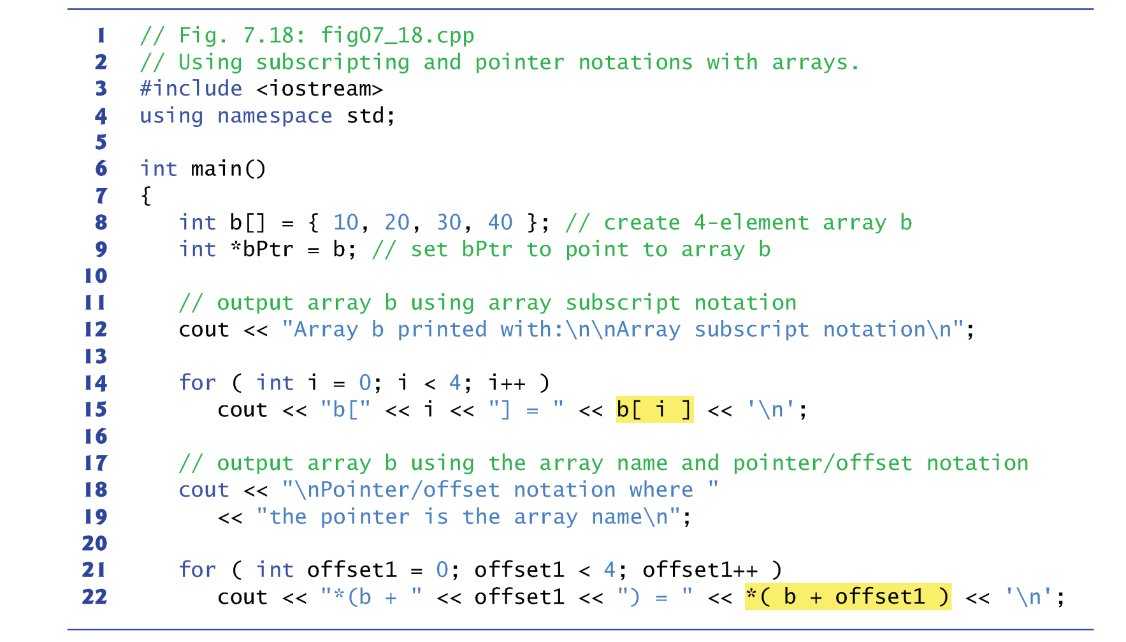
Relationship between Pointers and Array

Slide 15
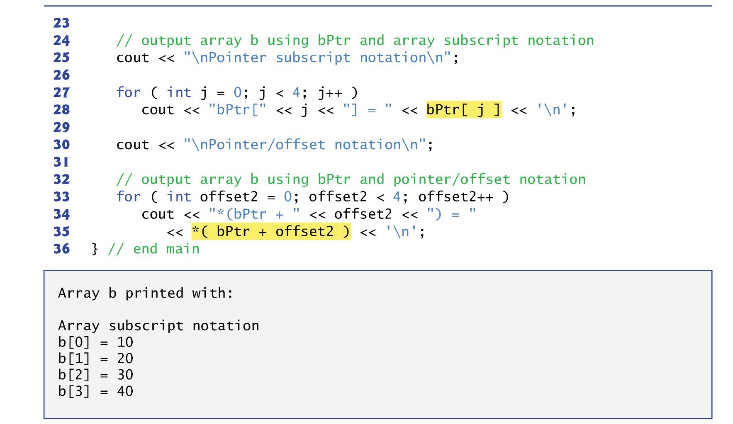
Relationship between Pointers and Array

Slide 16
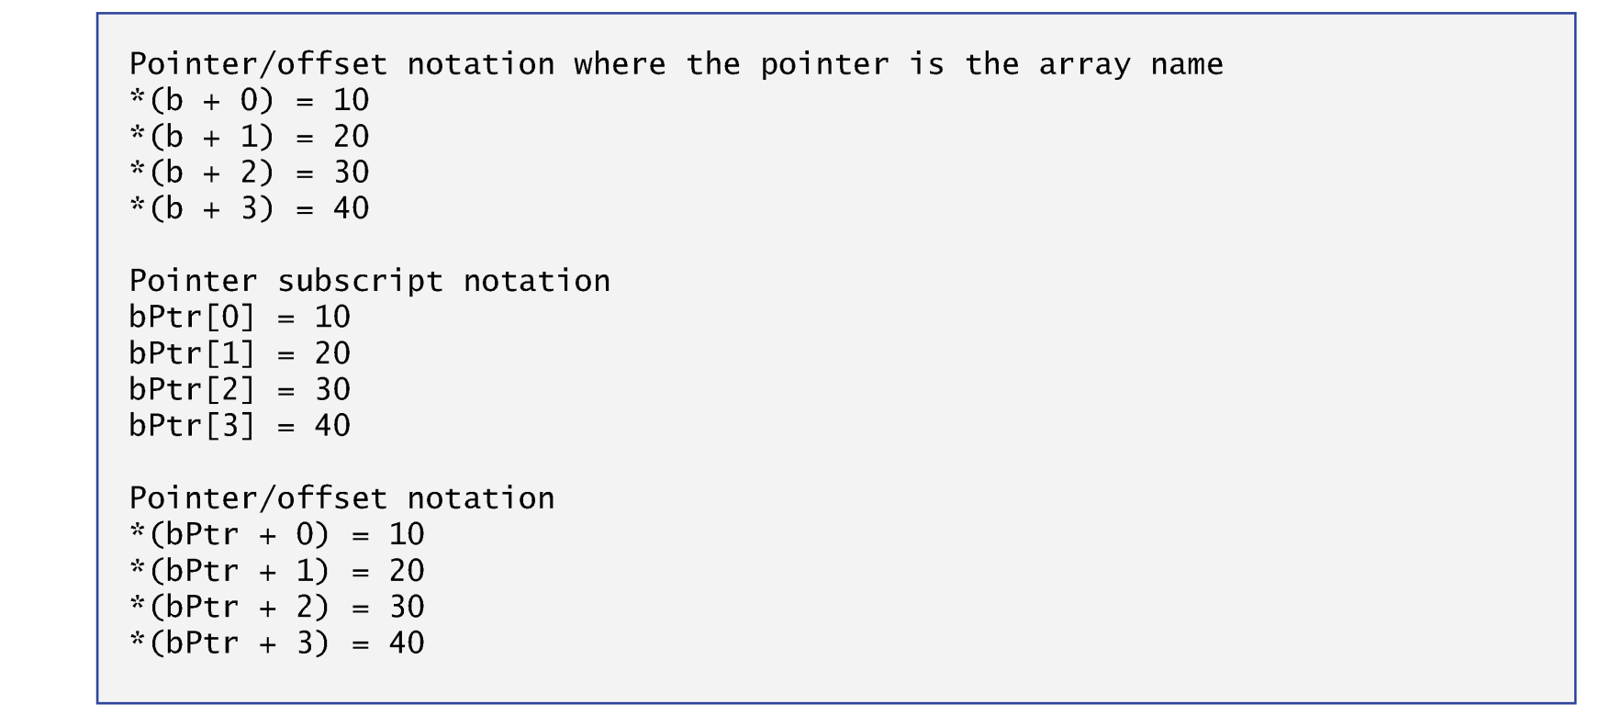
Relationship between Pointers and Array

Slide 17
Pointer-based String
Character constant
An integer value represented as a character in single quotes.
The value of a character constant is the integer value of the character in the machine’s character set.
A string is a series of characters treated as a single unit.
May include letters, digits and various special characters such as +, -, *, /and $.
String literals, or string constants, in C++ are written in double quotation marks
A pointer-based string is an array of characters ending with a null character ( \0 ).
Ex: “happy” → ‘h’, ‘a’, ‘p’, ‘p’, ‘y’, ‘\0’

Slide 18
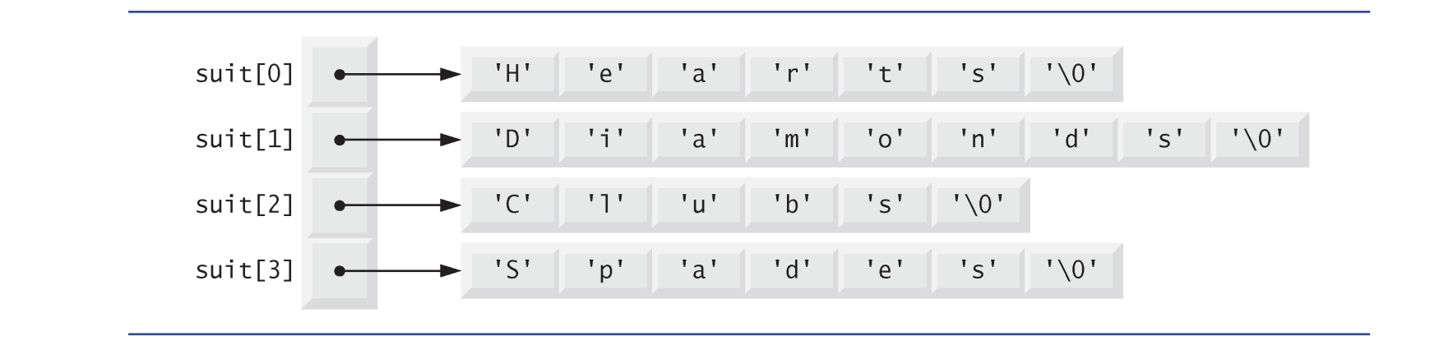
Pointer-based String
cout << suit[0]; → print out “Hearts”
cout << suit[2]; → print out “Clubs”
What will be printed by the following program?
for (int i=0; i<10; i++) {
idx = rand()%4;
cout << suit[idx];
}

Slide 19
Summary
Pointer Arithmetic
Query the size of types
Relationship between Pointer and Array
Pointer-based string

